Slide 1
Credit Risk & Loan Analysis
Nahum Ghebrehiwet

Slide 2

Introduction
Banks are financial institutions that provide loans to a variety of borrowers for a variety of reasons.
Banks need to identify which potential loans are high or low risk to minimize defaults.
The project analyzes credit risk for different borrowers and loan types.

Slide 3
Data
The data simulates credit bureau data such as the 3 major U.S credit bureaus
The data was modified to remove data entry errors

Slide 4
Methods and Tools
This analysis uses multiple software programs.
SQL functions include group by, count, sum, CTE, case, and window functions.
Microsoft Power BI was used to better visualize the results.

Slide 5
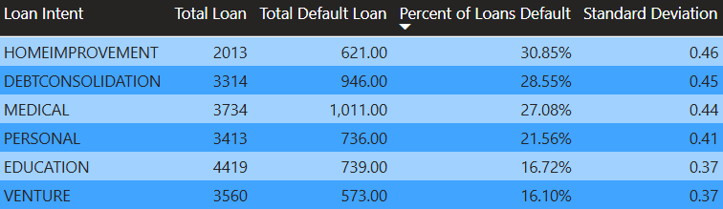
Loan Defaults by Loan Intent
The table shows the loan default percentage by loan intent.
Home Improvement, debt consolidation, and medical loans have the highest risk of loans defaulting.

Slide 6
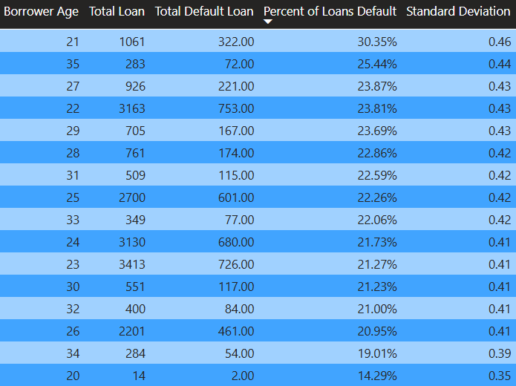
Loan Defaults by age
This table shows loan defaults by age
Borrowers aged 21 have the highest percentage chance of loan default.

Slide 7
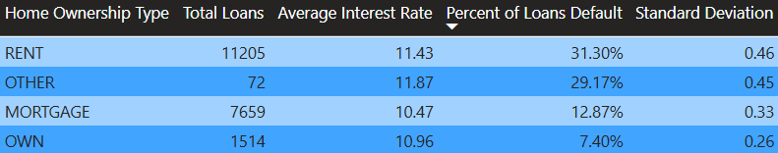
Loan Defaults by Home Ownership
The table shows types of home ownership with the percentage of loans defaulting.
Rent has the highest percentage of loans defaulting.

Slide 8
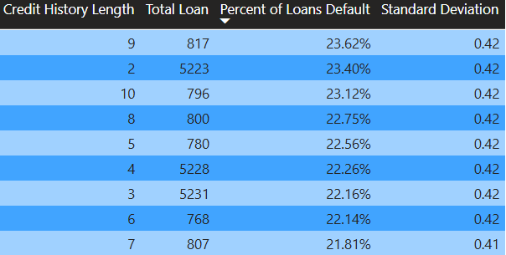
Loan Defaults by Credit Length History
Little/no relationship

Slide 9
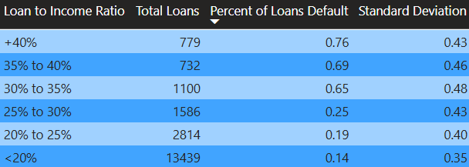
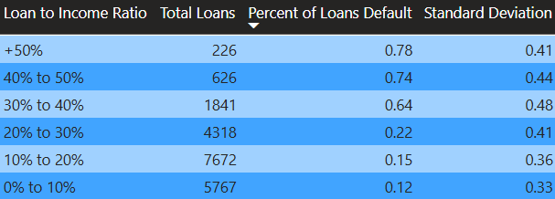
Loan Defaults by Loan-to-Income Ratio
The tables show the percentage of loans default by loan-to-income ratio
Significant jump in risk when loan-to-income ratio is greater than 30%.

Slide 10
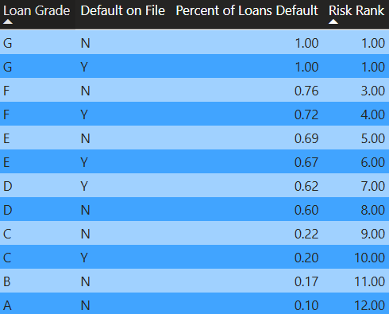
Loan Defaults by Loan Grade & Default on File
This shows loan defaults by loan grade and default on file
Significant gap between loan grades C and D.

Slide 11
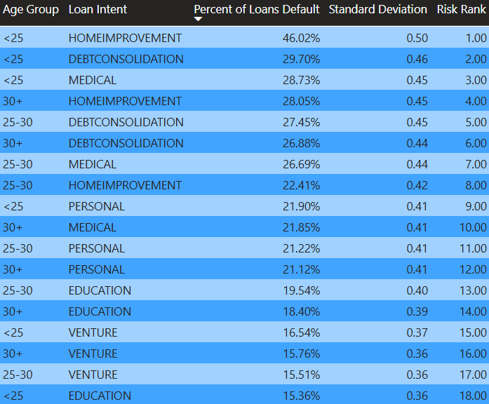
Age Group and Loan Intent
This table shows loan intent and age group
Notice major outliers

Slide 12
High Risk Loans
According to the analysis conducted, borrower characteristics that have the highest risk are:
Home Improvement loans
Borrowers under 25 (except for education)
Loan Grades D-G
Loan-to-Income ratio greater than 30%
Renters

Slide 13
Low Risk Loans
According to the analysis conducted, borrower characteristics that have the lowest risk are:
Under 25 borrowers with education intent
Loan grades A-C
Loan-to-Income ratio below 30%
Borrowers who own their home
Venture loan intent

